Slide 1
WPF Partner Showcase
V6 07/09/2008

Slide 2
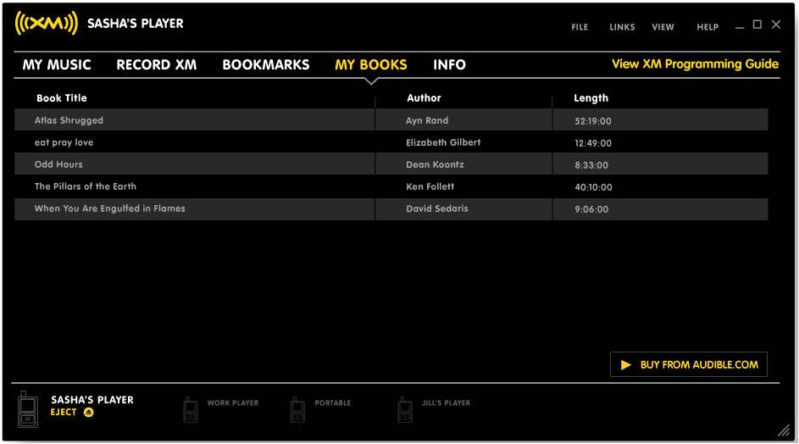
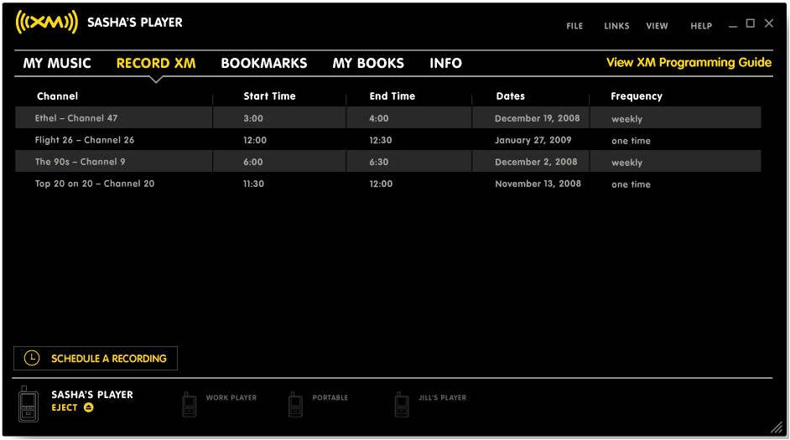
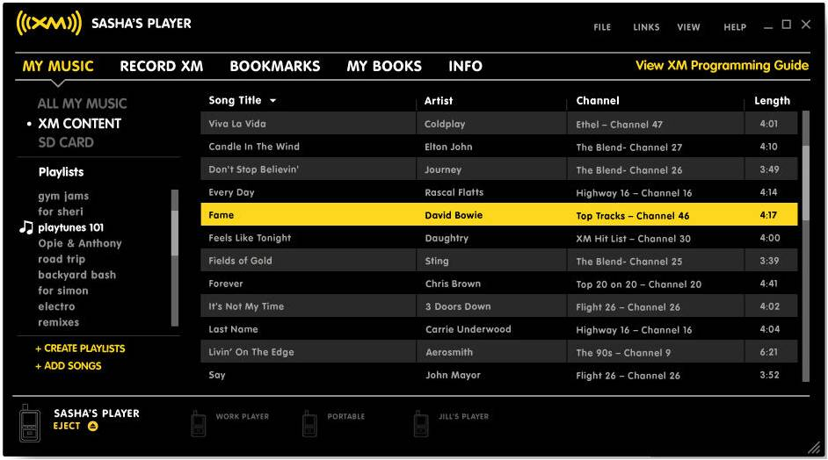
XMRadio, XM2Go Music Manager
Manages XM Radio devices and content. Allows to manage and organize content, schedule recordings, manage bookmarks, and create playlists.
Status: Shipping http://www.xmradio.com/xm2gomusicmanager/index.xmc

Slide 3
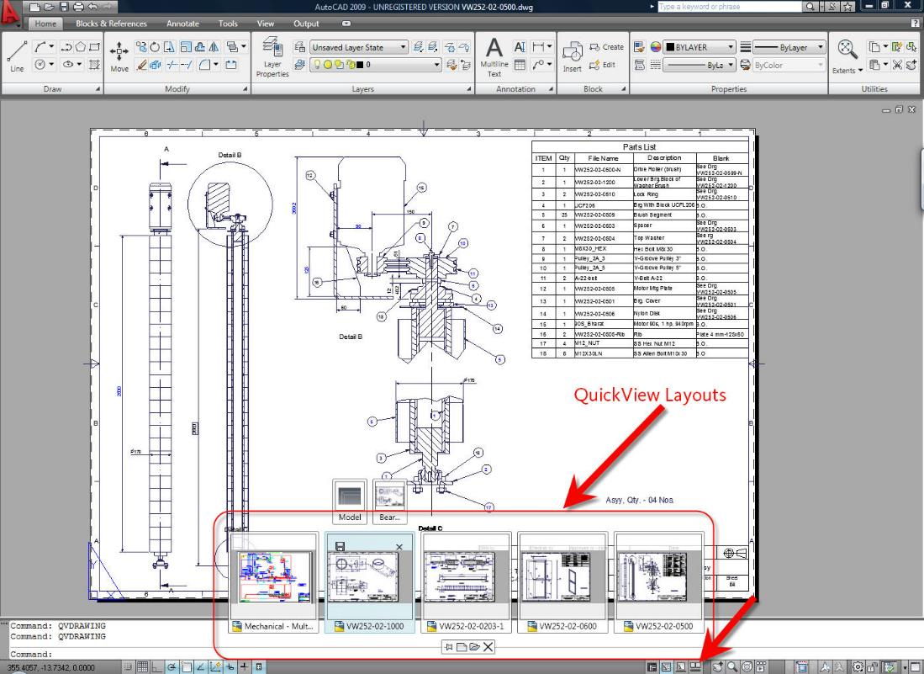
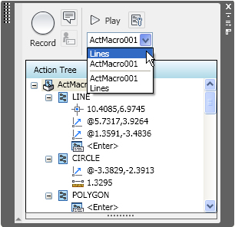
AutoCAD 2009
Using WPF for application chrome: ribbon, action recorder and QuickView Status: Shipping
Trial: http://usa.autodesk.com/adsk/servlet/index?siteID=123112&id=2704278

Slide 4
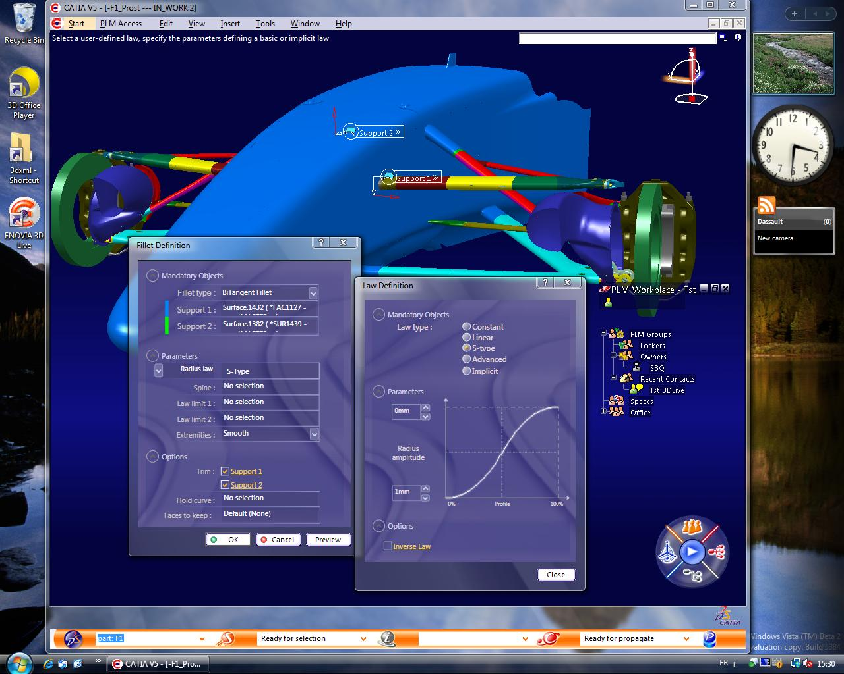
Dassault Systèmes CATIA v5
3D modeling and design tool
Status: Completed

Slide 5
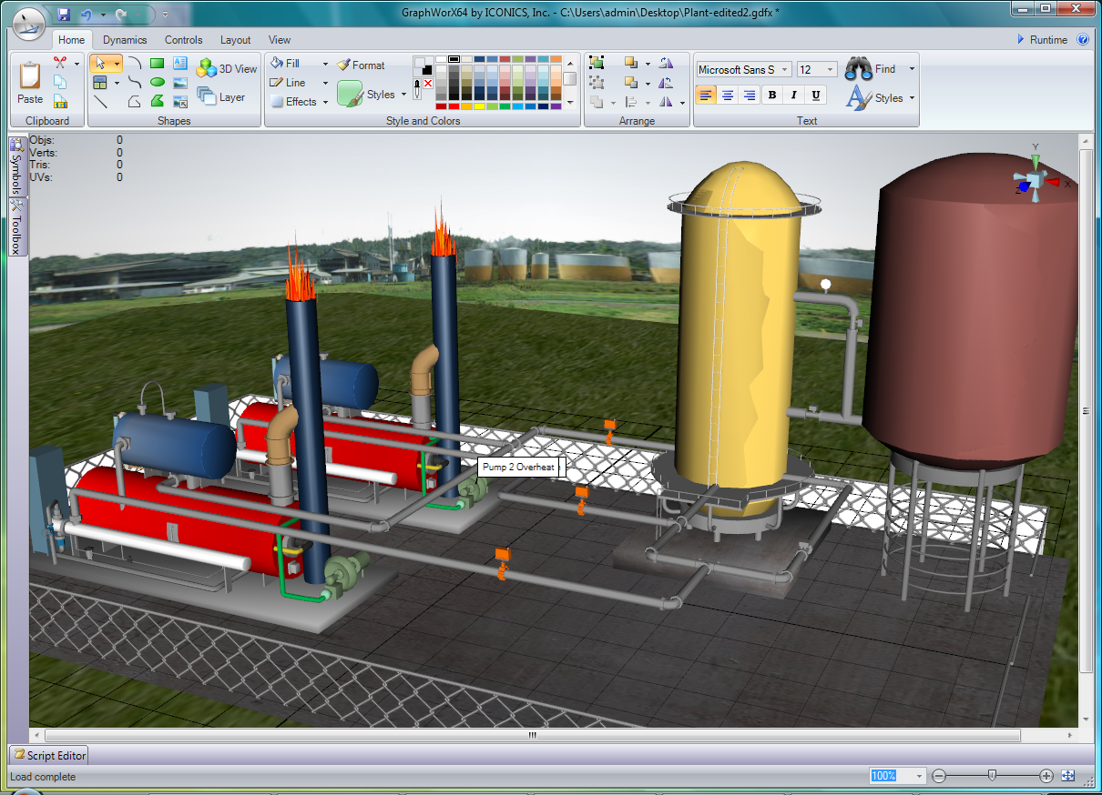
Iconics
3D manufacturing solution for real time monitoring and troubleshooting.
Status: Shipping
Info: http://www.iconics.com/products/genesis64.asp

Slide 6
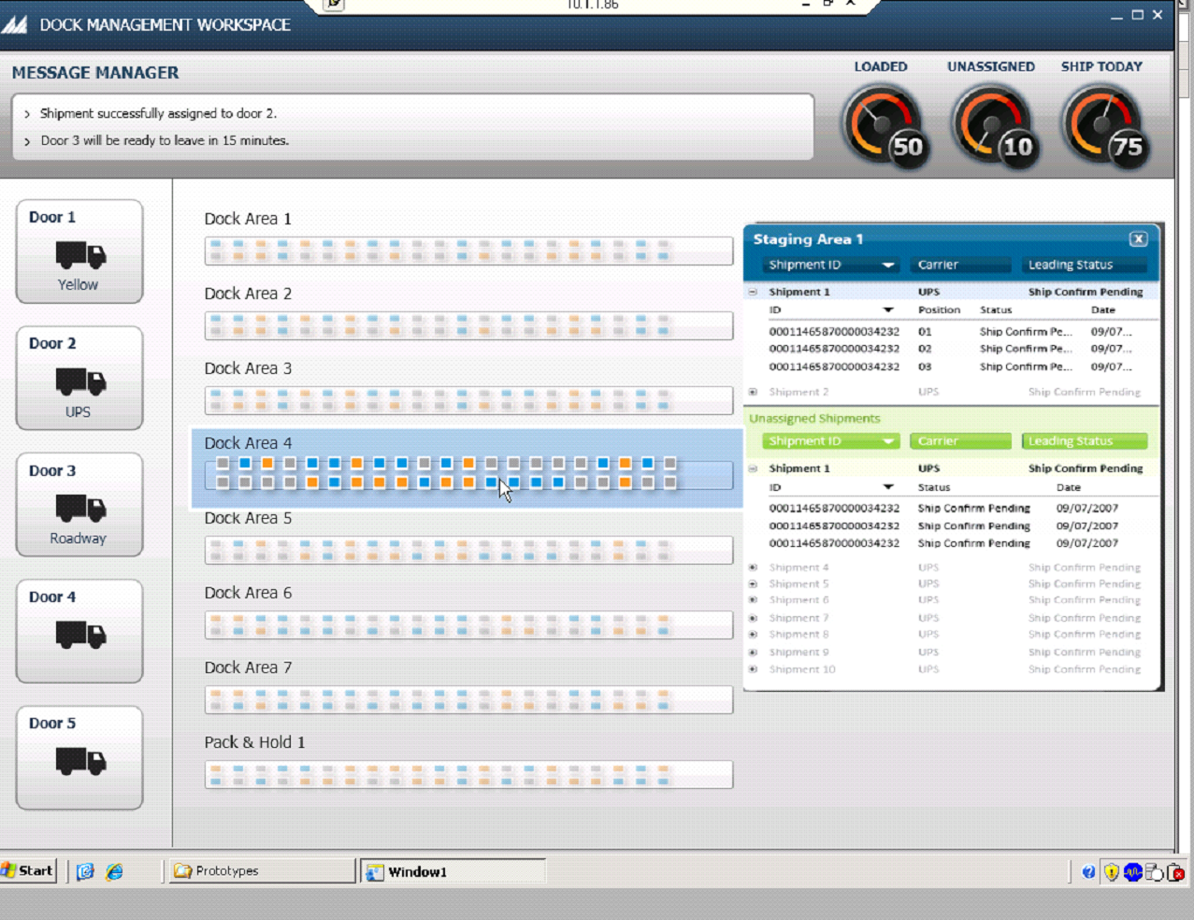
Manhattan Associates: Integrated Logistics Solutions (ILS)
Supply Chain Optimization
Status: Shipping
Info: http://www.manh.com/ils_net/

Slide 7
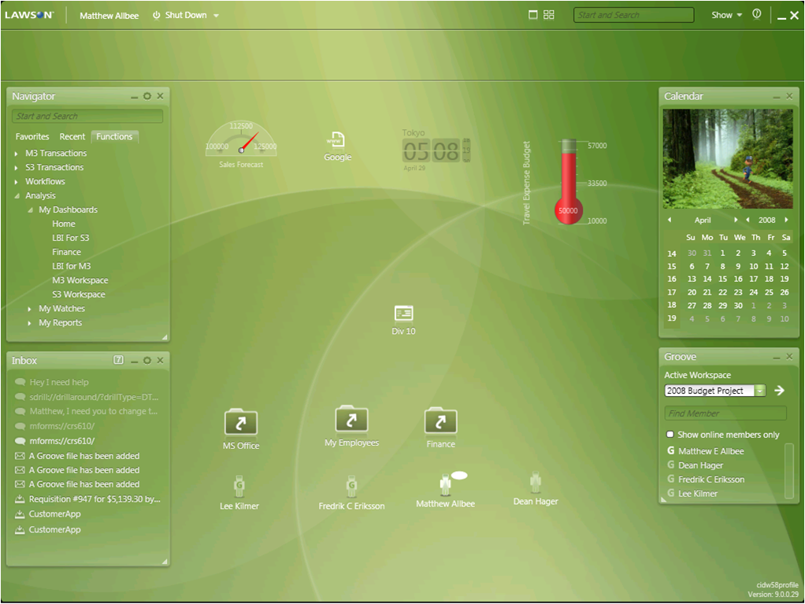
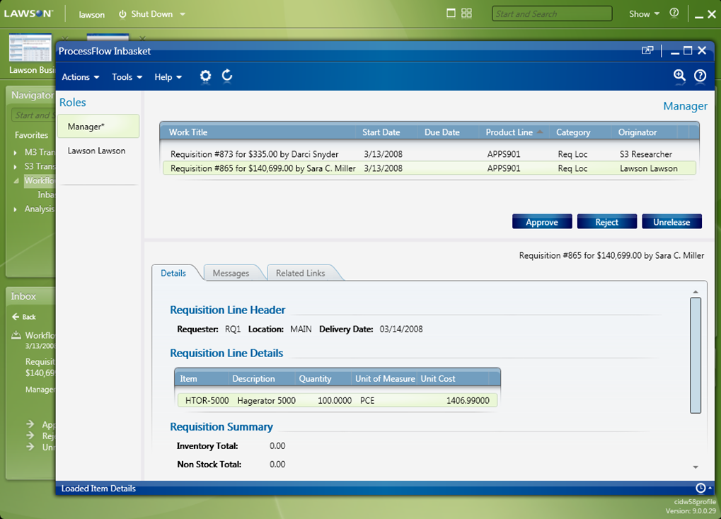
Lawson M3 Smart Client
Lawson’s flagship application for manufacturing and distribution companies Status: Shipping
Case study: http://www.frogdesign.com/pdf/frog_design_lawson.pdf

Slide 8
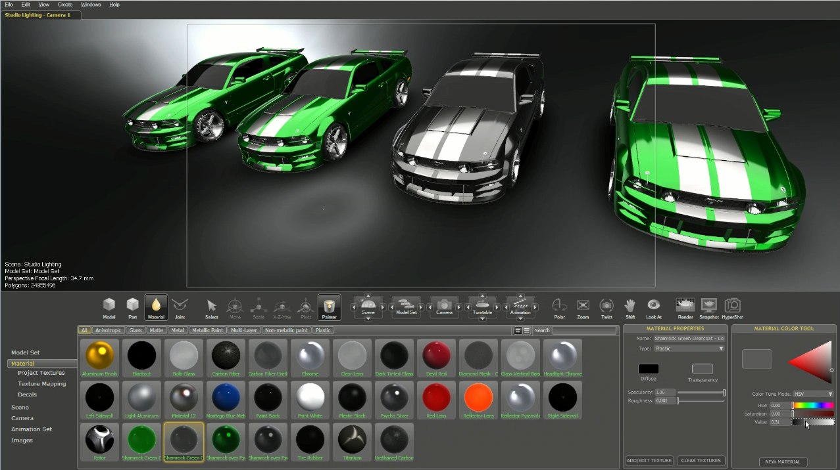
BunkSpeed HyperDrive
Visualization and rendering application. Status: Shipping

Slide 9
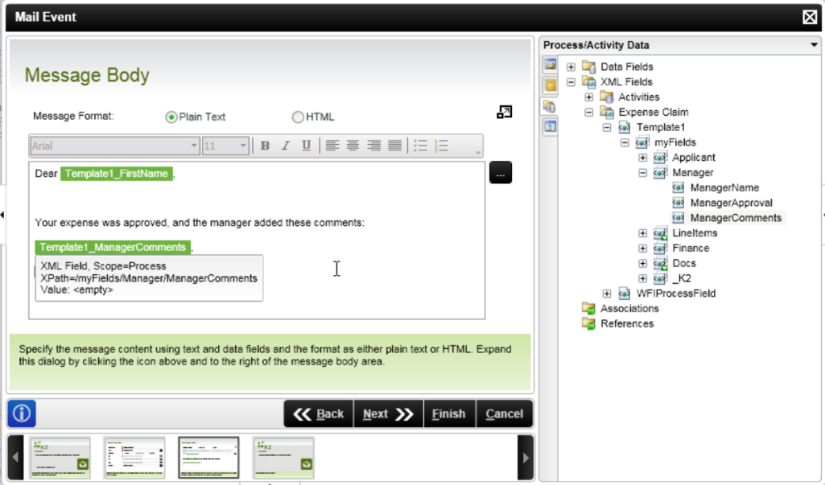
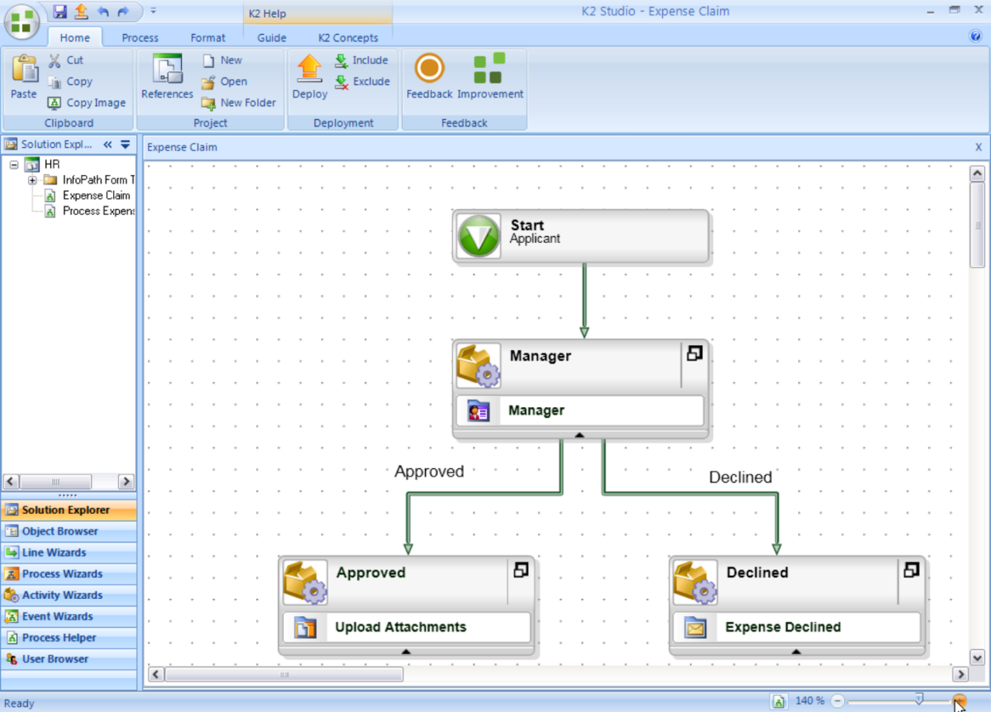
K2 Studio
Workflow Designer
Status: Near RTM

Slide 10
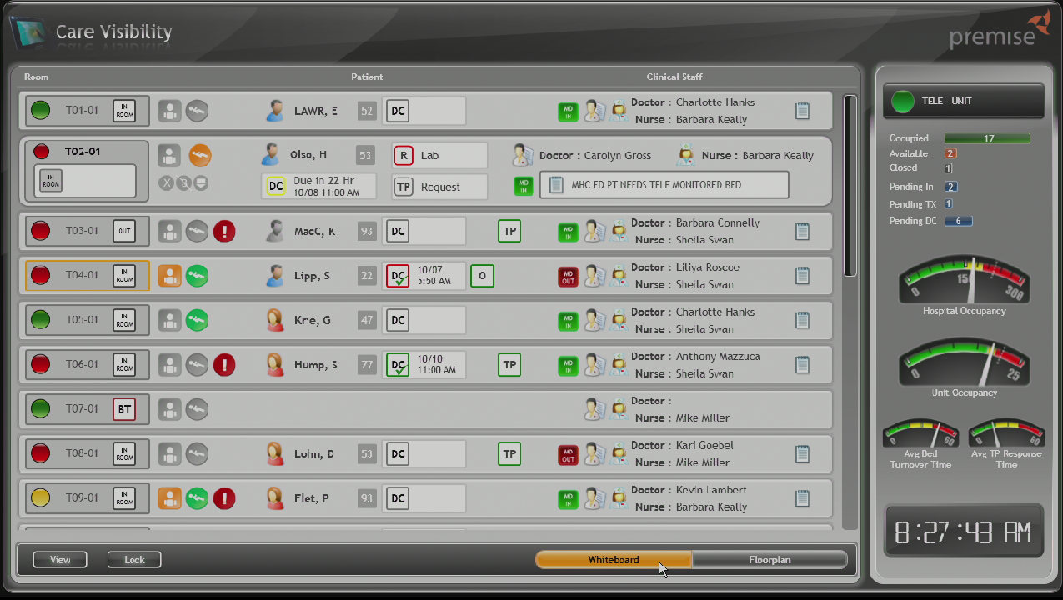
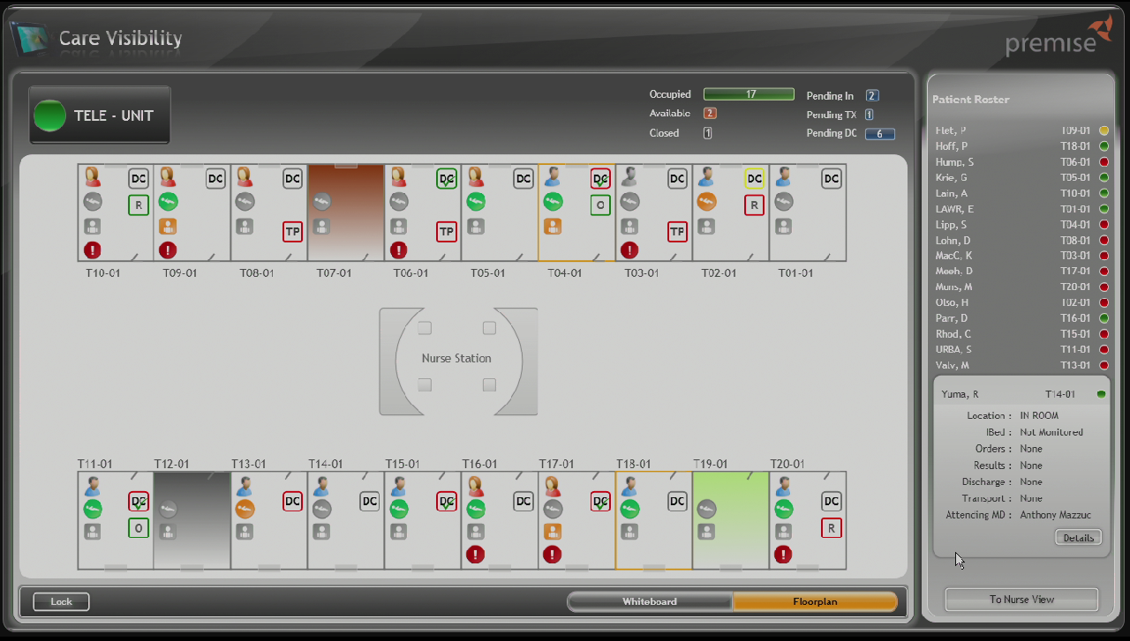
Premise, Care Visibility
Rich visualization and data entry that empowers physicians to provide better care at the bedside.

Slide 11
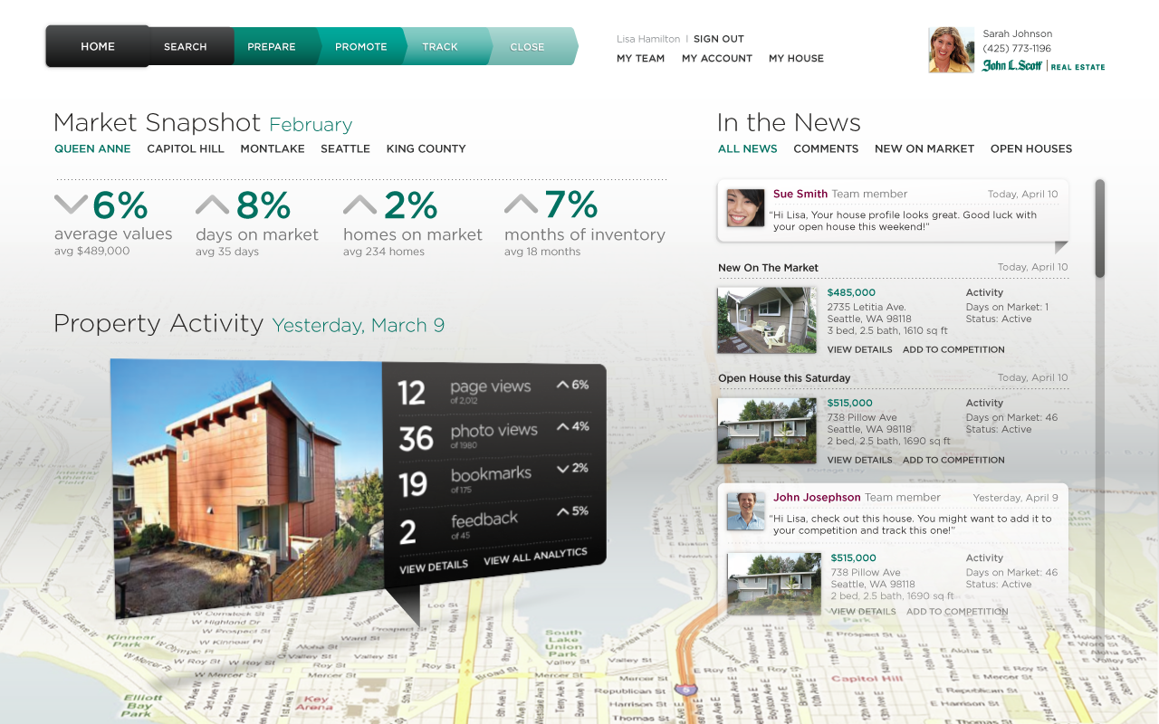
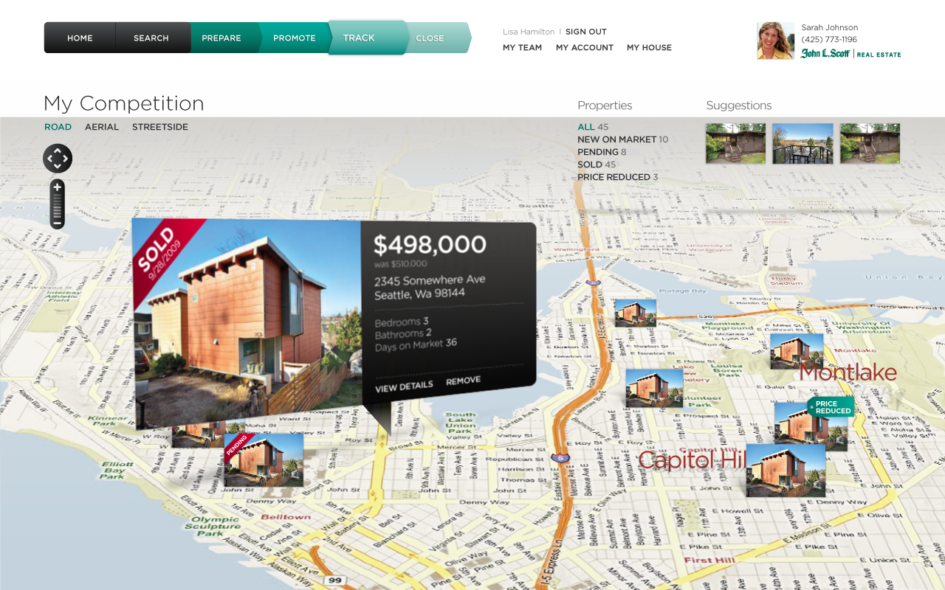
John L. Scott, Seller’s desktop
The application serves to optimize a home seller’s experience around marketing their home and it strengthens the relationship between agent and sellers
Status: Shipping

Slide 12
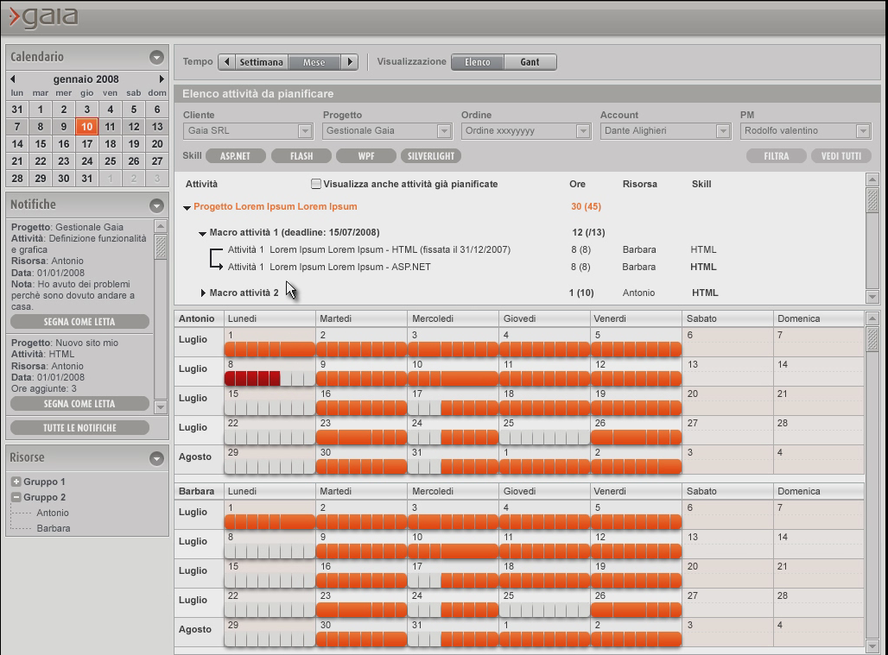
Gaia, Mozart
Project management application that empowers decisions makers to manage schedules, resources, risks, help desk, budgets, etc.
Status: Shipping

Slide 13
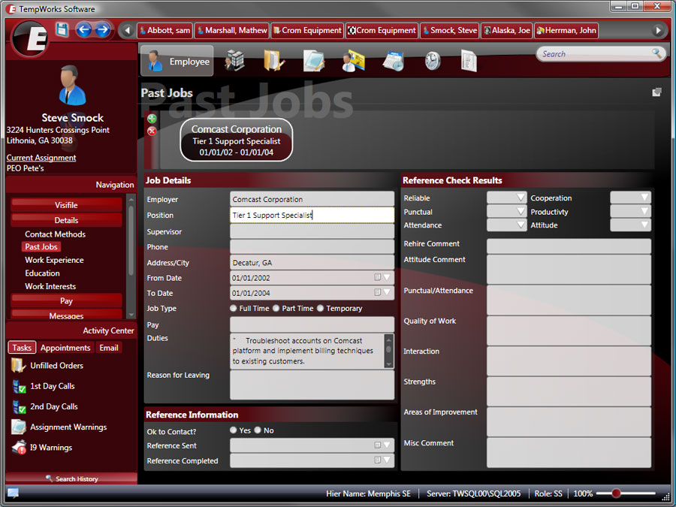
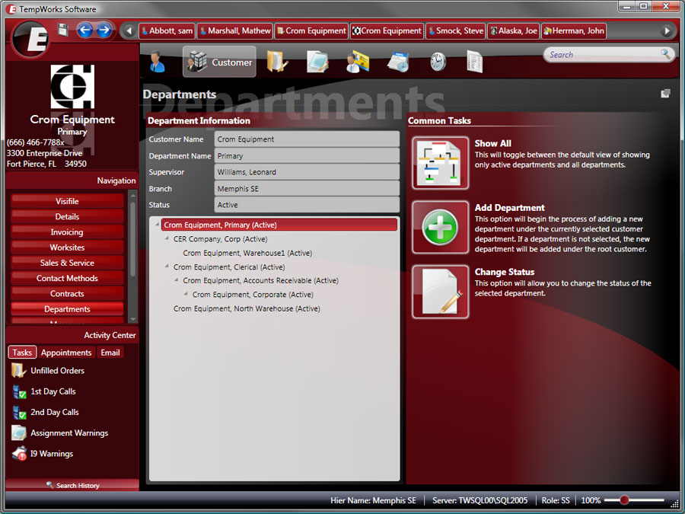
Tempworks Enterprise
Enterprise staffing management solution
Status: Shipping
More Info: http://www.tempworks.com/Enterprise.aspx

Slide 14
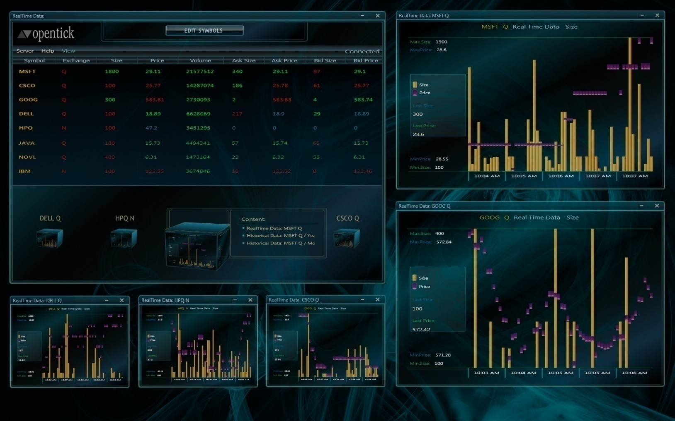
Eikos Partners: OpenTick
Opentick is an open-source data provider that delivers free real-time
and historical market data for trading systems and trading platforms.
Status: Shipping

Slide 15
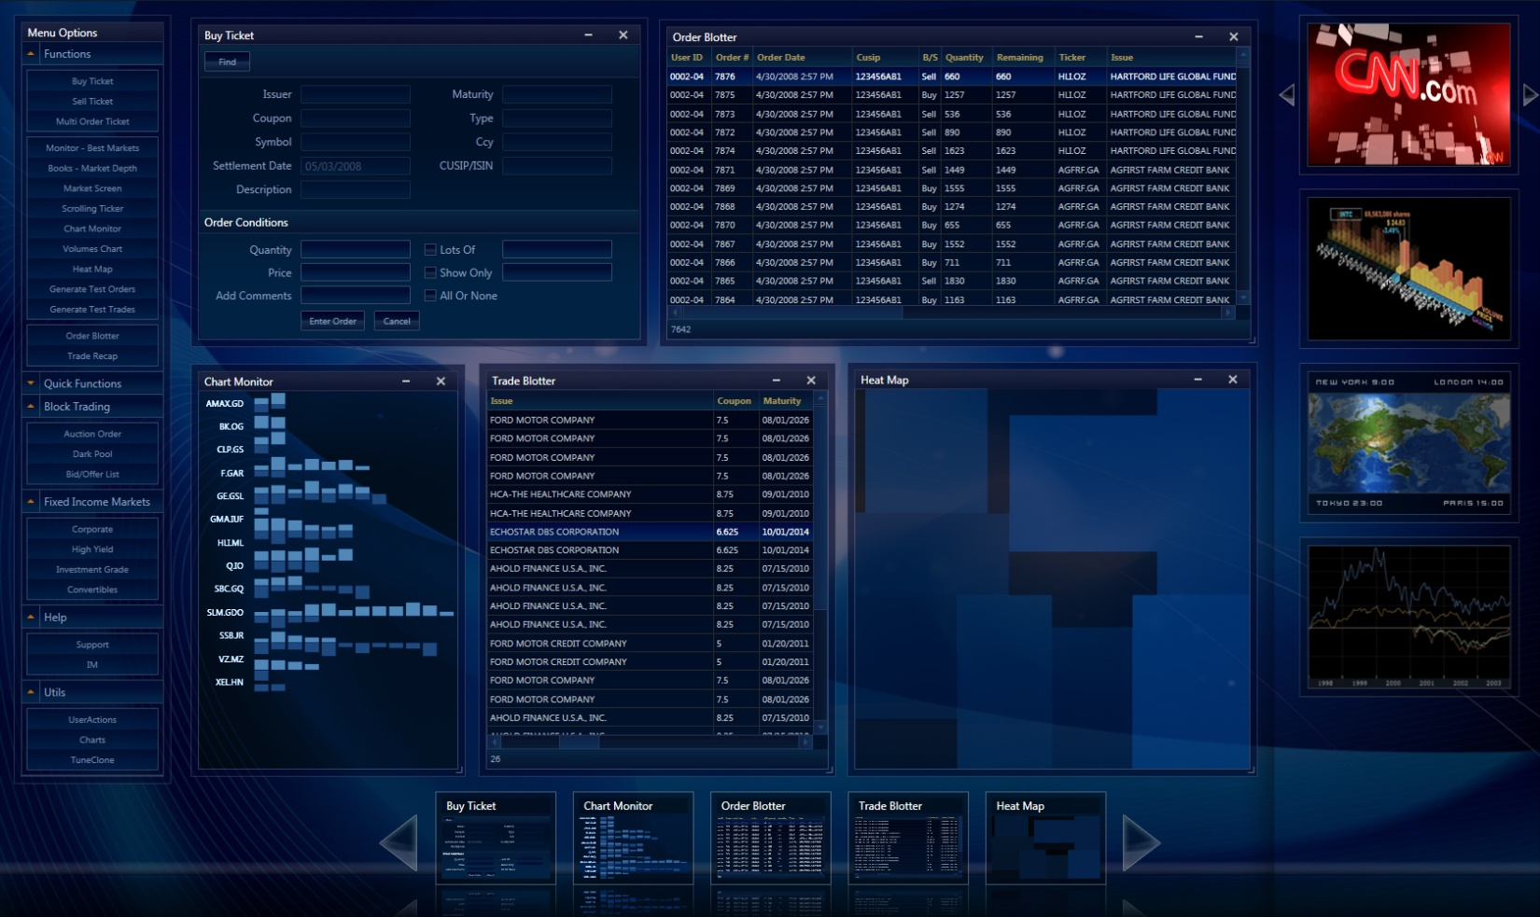
Eikos Partners: EPTrading
UIFramework for trading application.
Status: Shipping

Slide 16
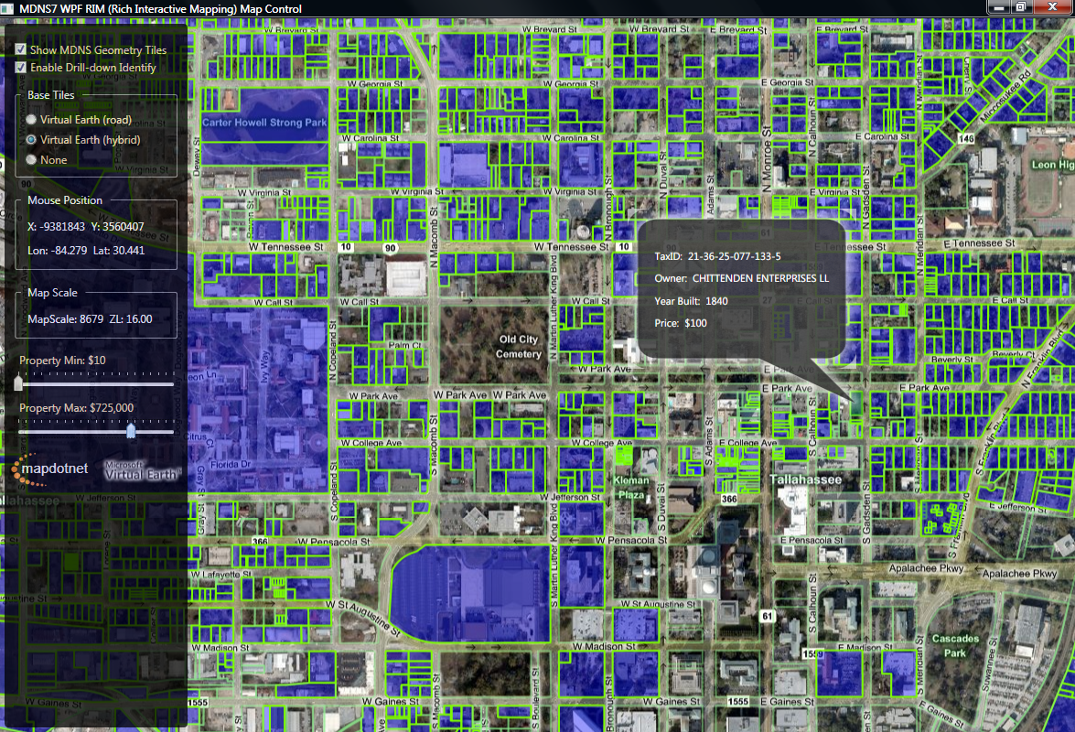
MapDotNet Server 7
GIS mapping software based on Virtual Earth
Status: In development
Notes:
Contact: Sonny Ali

Slide 17
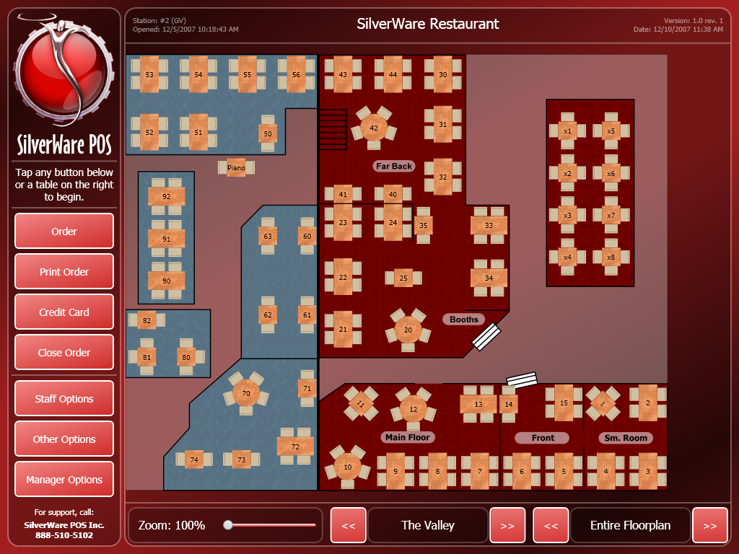
SilverWare
SilverWare Avrio is a powerful hospitality industry solution with a highly intuitive GUI that makes it one of the most accessible P.O.S. solutions that restaurateurs and staff can use.
Status: Shipping

Slide 18
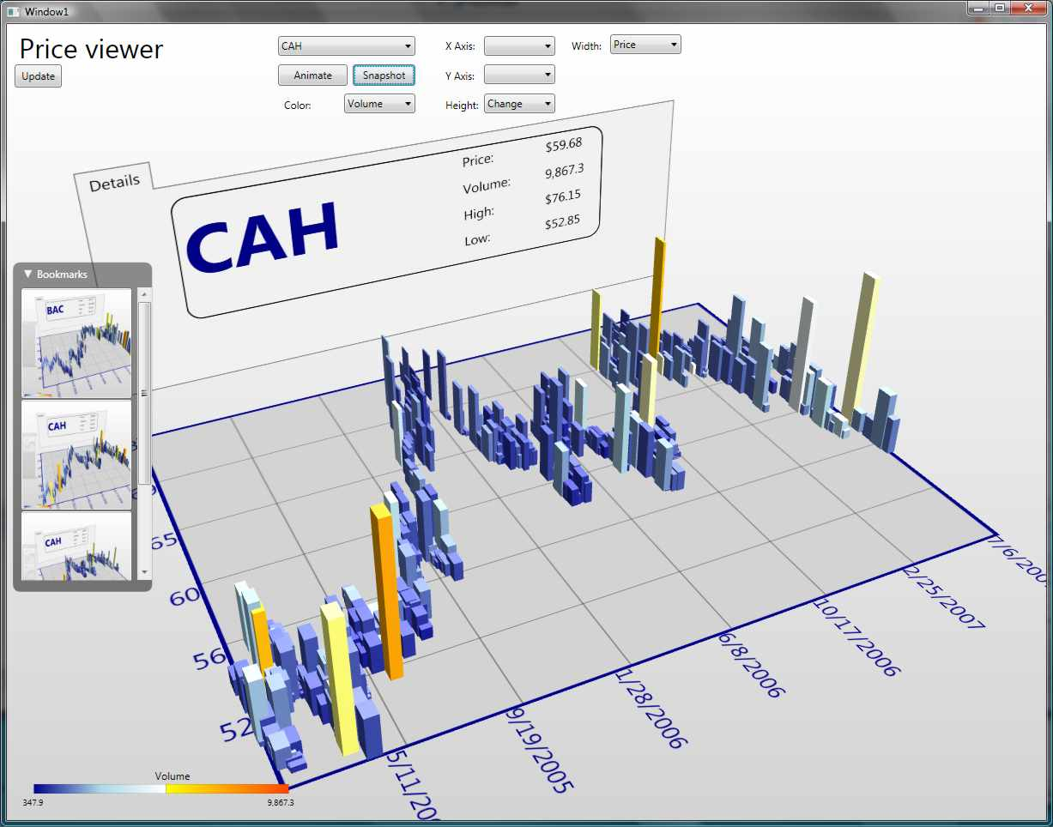
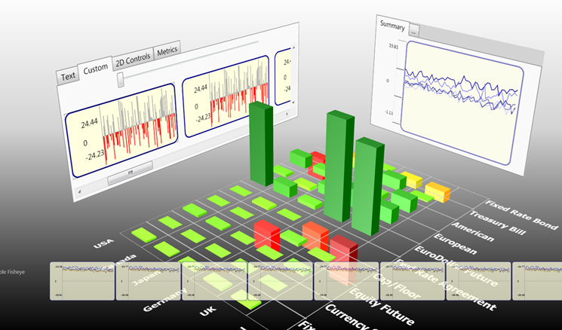
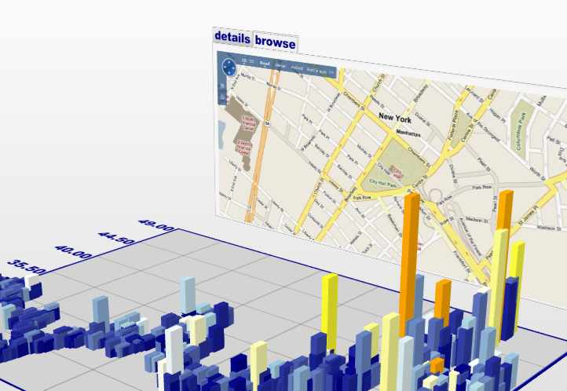
Oculus
Oculus.WPF is a 3D visualization library used to rapidly build enterprise visualization solutions.
Status: Shipping

Slide 19
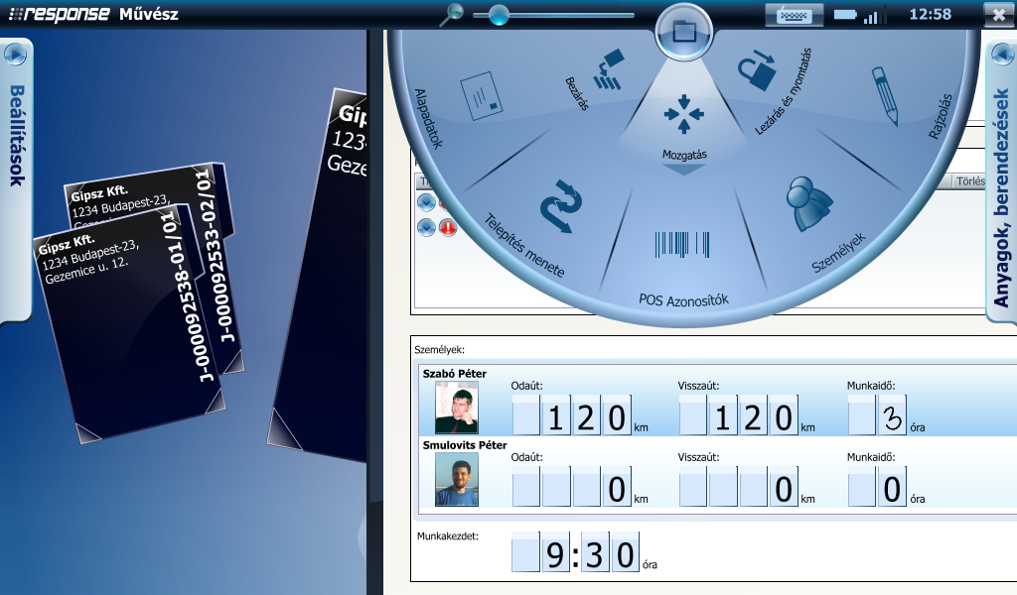
Művész
Covers the full range of the service operation from inventory to billing; from trouble ticketing to distribution and verification of work for more than 100 technicians performing the maintenance and installation tasks.
Status: Shipping

Slide 20
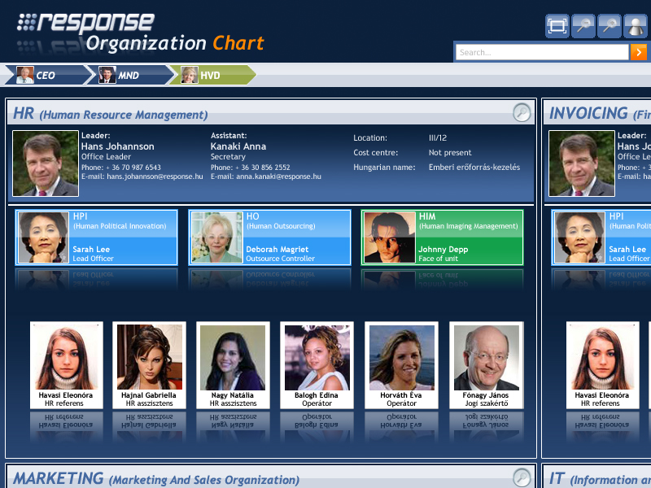
Response
Response is an application that organizations can use to visualize the relationships between organizational structures.
Status: Shipping

Slide 21
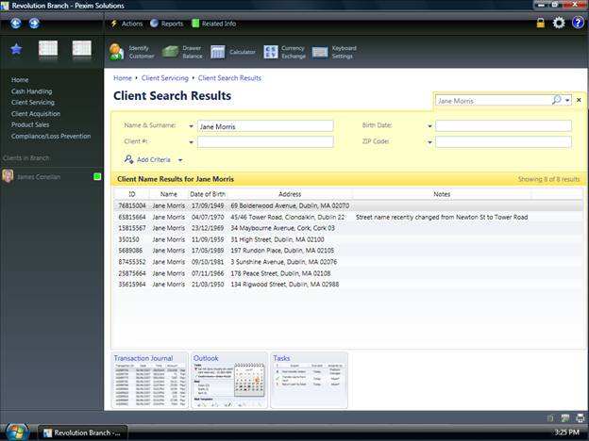
Pexim Revolution
Pexim Revolution is a next generation core banking system, built entirely on the .NET Framework 3.5.
Status: Shipping

Slide 22
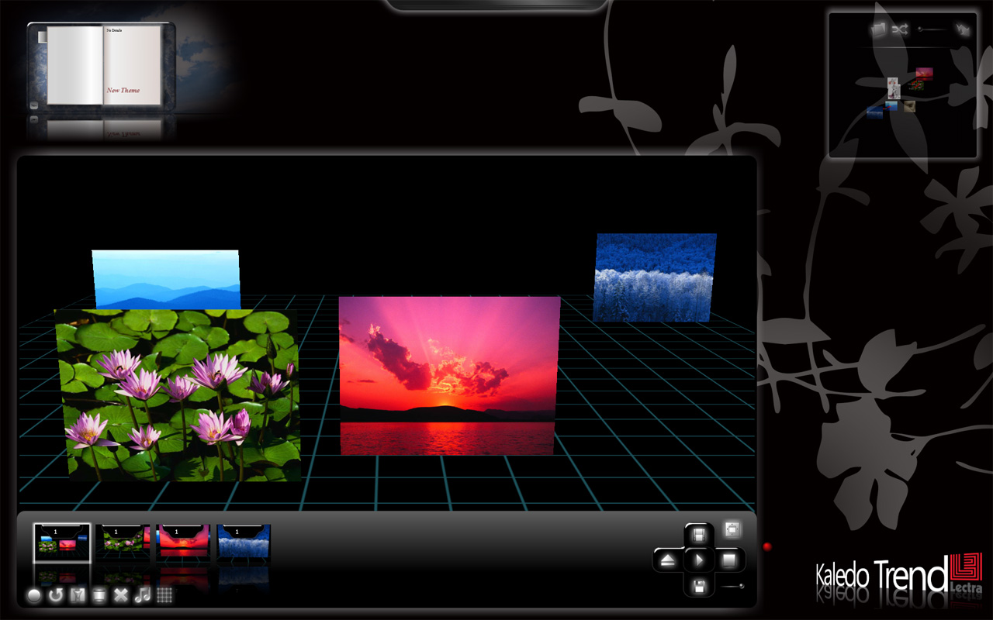
LECTRA
Create inspiration storyboards for fashion designers
Status: Shipping

Slide 23
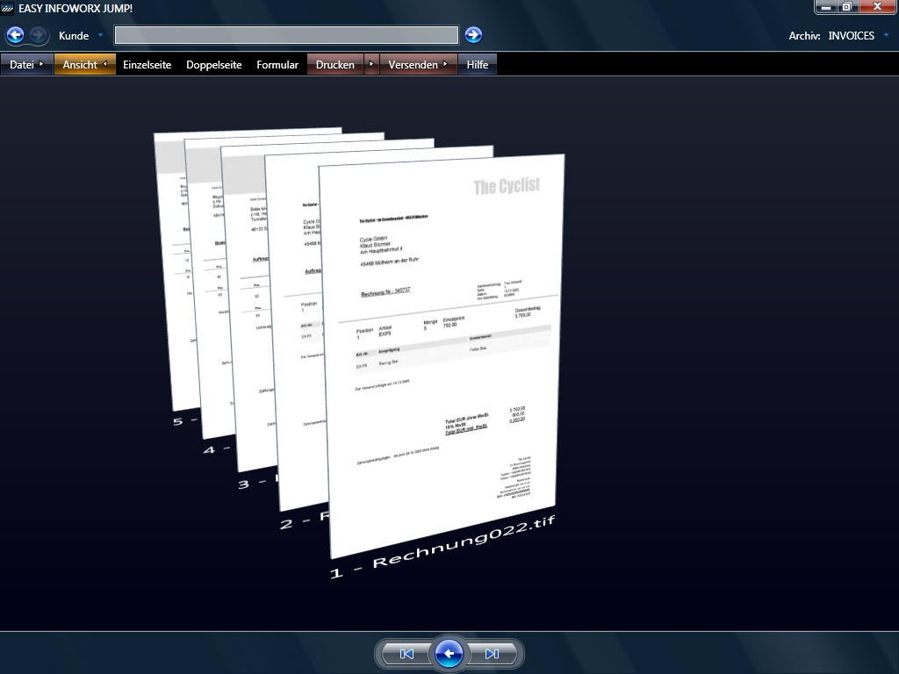
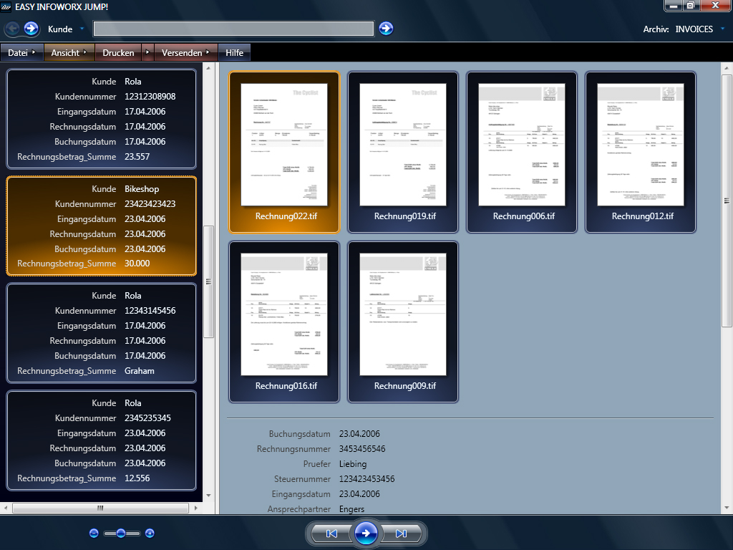
EASY Infoworx Jump!
Enterprise document management and archival solution
Web: http://www.easy.de

Slide 24
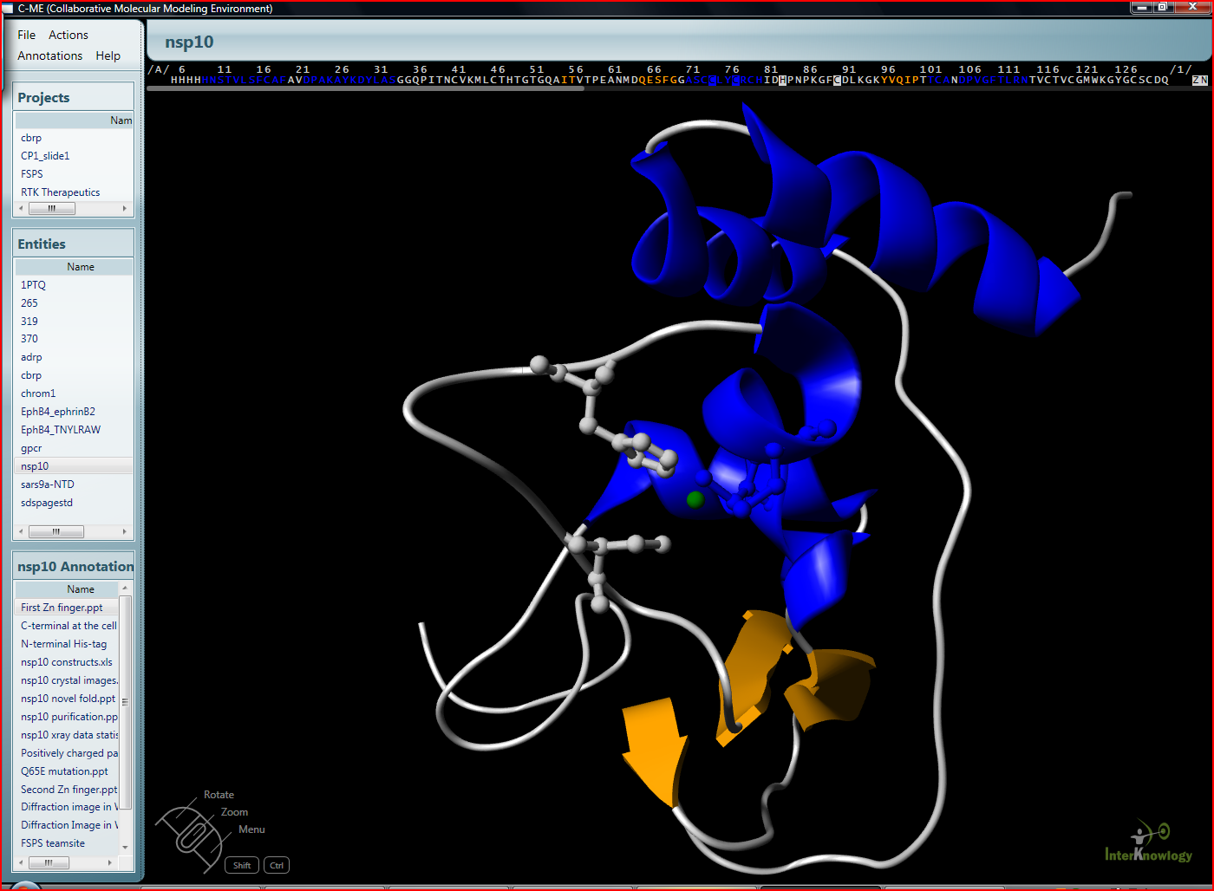
Scripps Healthcare
Allowing cancer researchers to collaborate in the search for a cure
Status: Late Beta (Shown at Windows Vista BV Launch)
PR: .NET Developer’s Journal

Slide 25
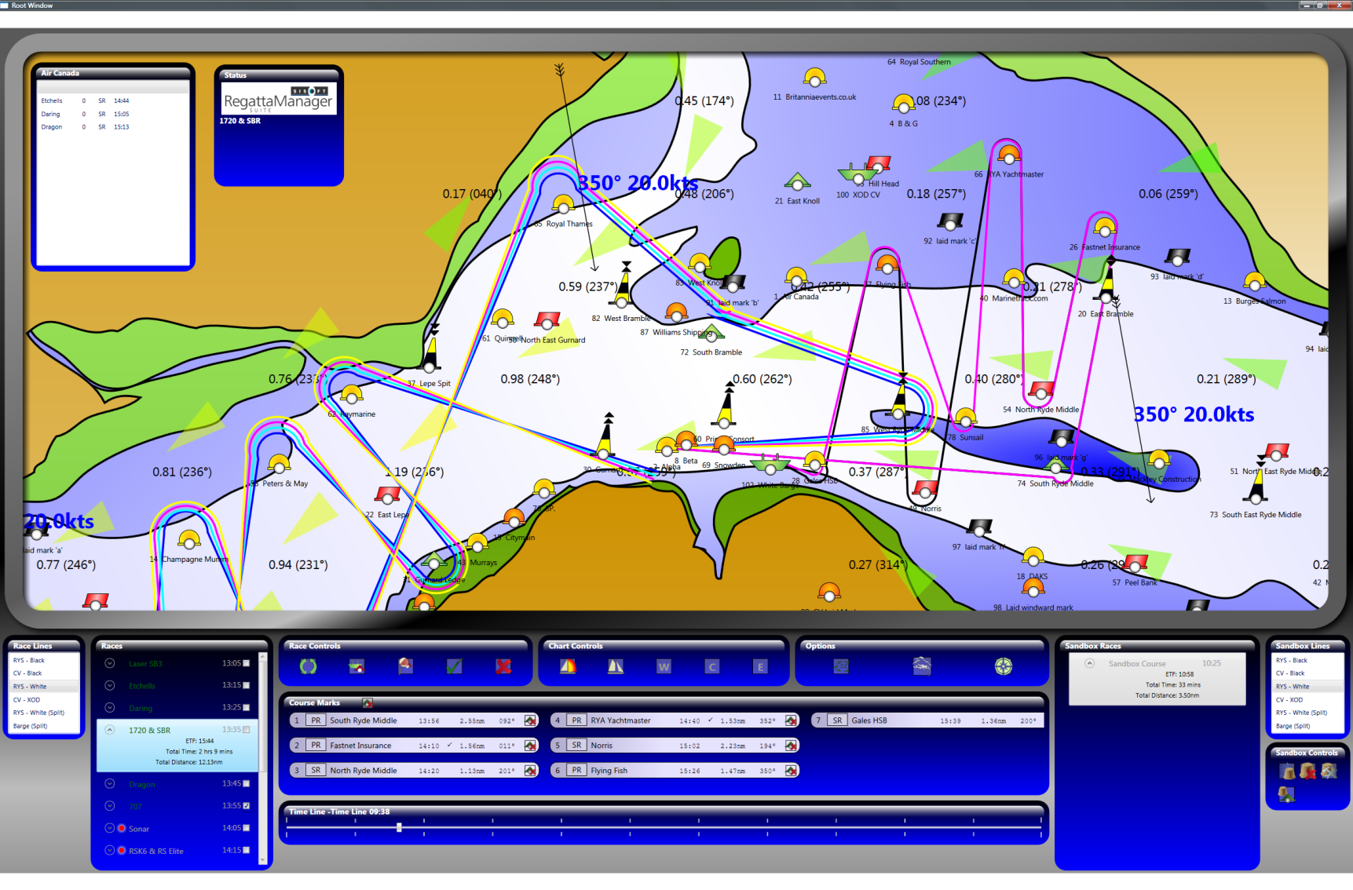
Skandia Cowes Week
Course setting software to plan and monitor a world-class sailing event
Status: Complete, used in production for 2006 event

Slide 26
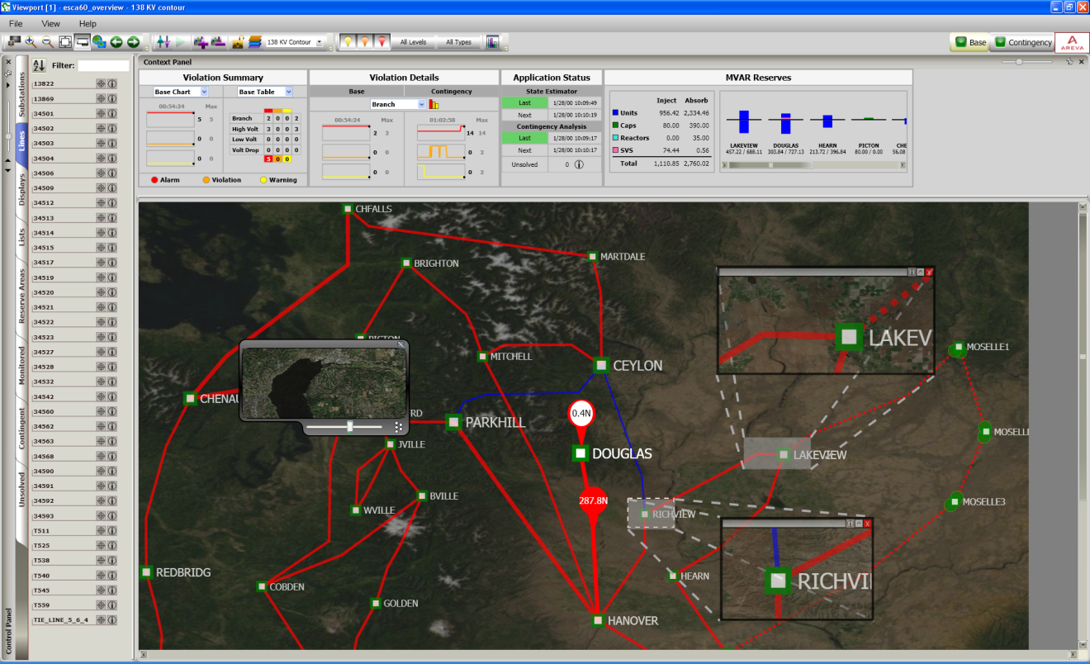
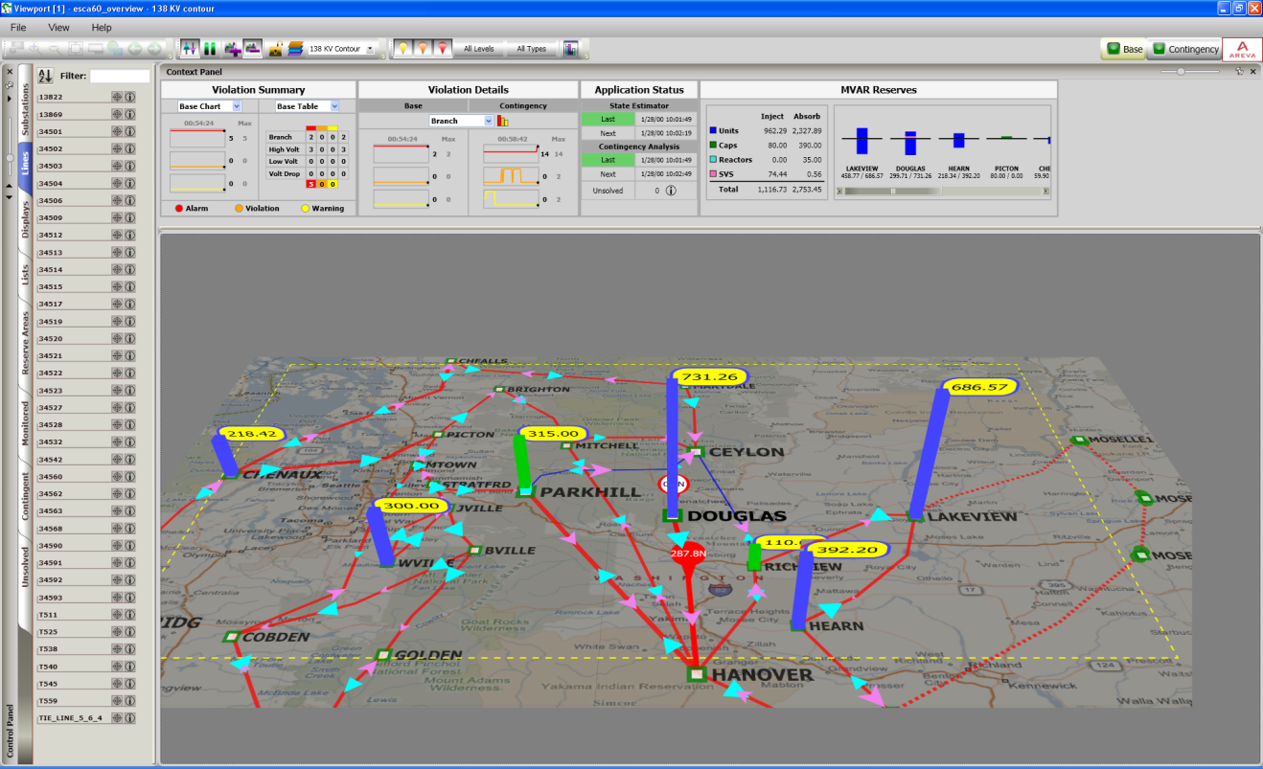
Areva
Monitoring and controlling the electricity power grid
Status: Shipping

